Slide 1


:
Laptop Dataset
Data Analysis
PROJECT WORKFLOW OVERVIEW :
1) Data Cleaning
2) Exploratory Data Analysis (EDA)
3) Data Visualization
4) Analysis and Interpretation
5) Documentation
Gaurav Kumar Singh - Data Analytics
Milestone – 1 (Python Data exploration Project) Date : 22-07-2024

Slide 2

Introduction
The objective of this project is to conduct a comprehensive data exploration, cleaning, and analysis to derive meaningful insights from the dataset.
Importance of data understanding, preprocessing, and visualization in data analytics projects :
1) Data Understanding:
Contextualization, Identifying Limitations and Feature Selection.
2) Data Preprocessing:
Data Quality, and Normalization and Feature Engineering.
3) Visualization:
Insight Generation, Communication and Decision Making.

Slide 3
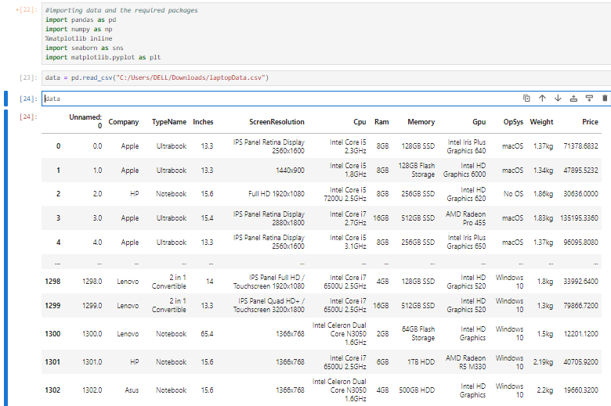
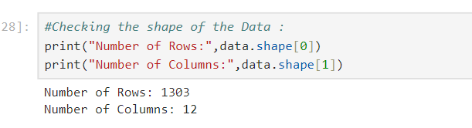
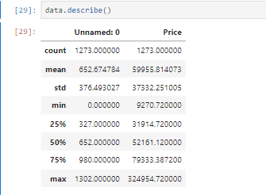
Data Understanding :
• Overview of the dataset structure: number of rows, columns, data types.
• Summary statistics: mean, median, min, max for numerical features.

Slide 4
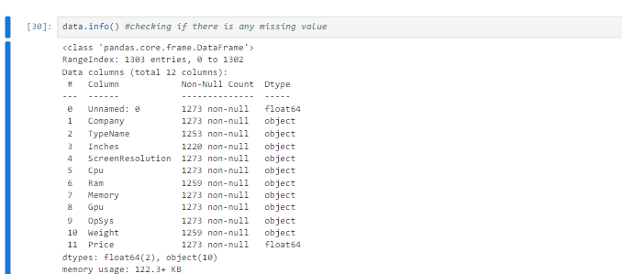
Data Understanding :

Slide 5
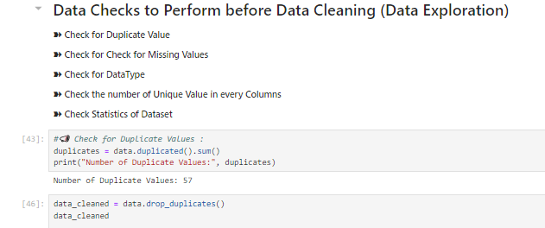
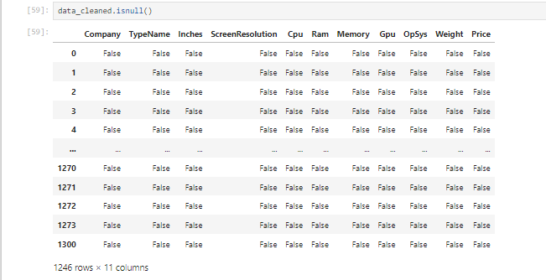
Initial Exploration
• Insights from initial exploration: any notable patterns, outliers, or missing values observed.

Slide 6
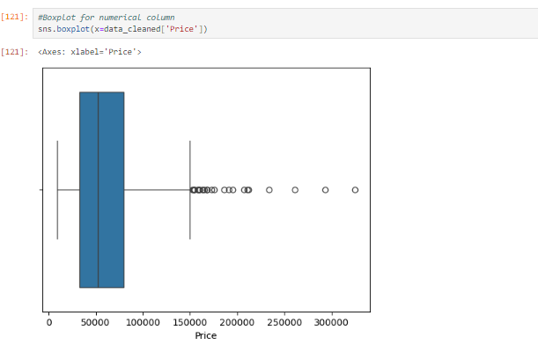
Initial Exploration

Slide 7
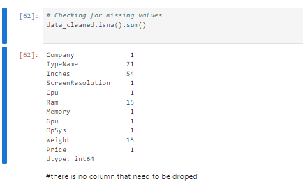
Missing Values Handling
• Techniques used to detect missing values.
• Techniques used to handle missing values (e.g., imputation, deletion).
• Before-and-after comparison: Shape of the dataset

Slide 8
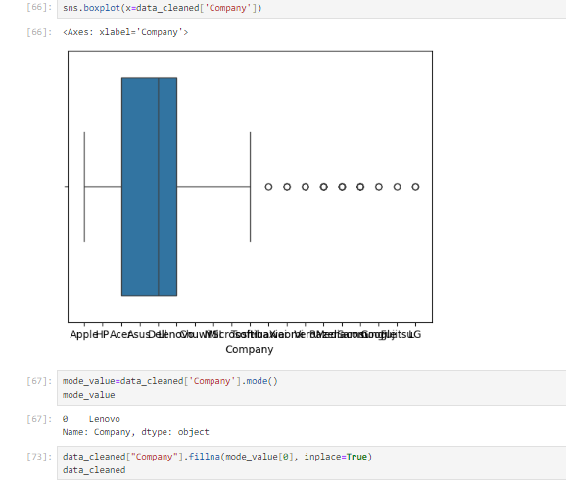
Missing Values Handling

Slide 9
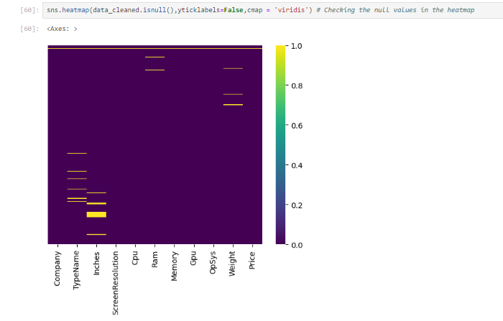
Missing Values Handling

Slide 10
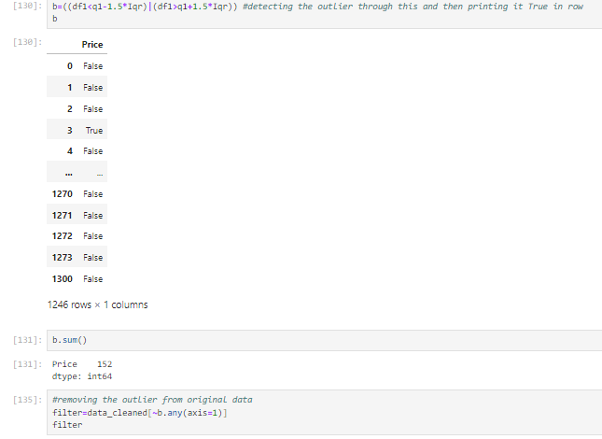
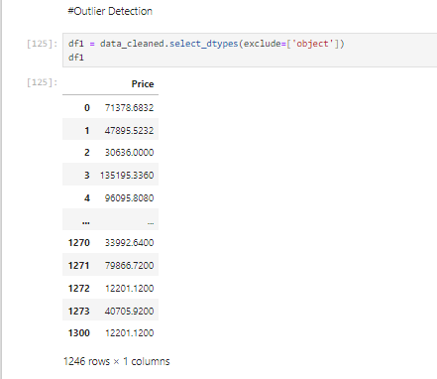
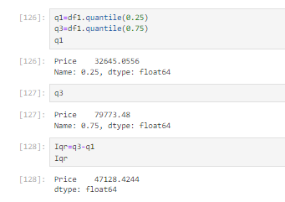
Outlier Detection
• Strategies for identifying and handling outliers (e.g., removal, transformation).
• Box plots or scatter plots to visualize outliers in numerical features.
• Explanation of outlier removal techniques and impact on the dataset

Slide 11
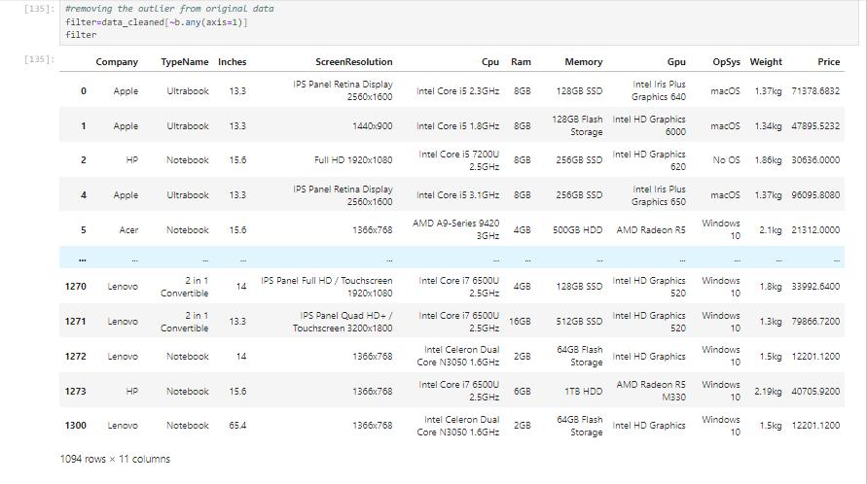
Outlier Removal

Slide 12
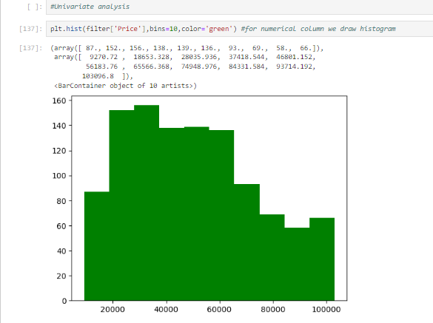
Univariate Analysis

Slide 13
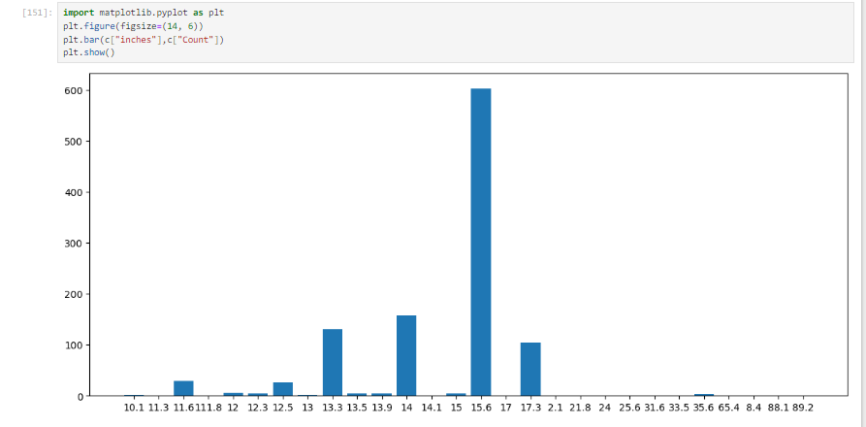
Univariate Analysis

Slide 14
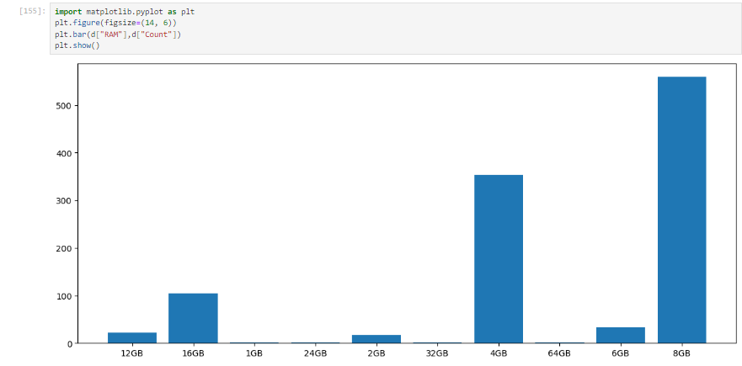
Univariate Analysis

Slide 15
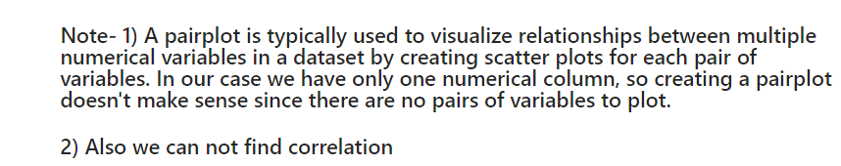
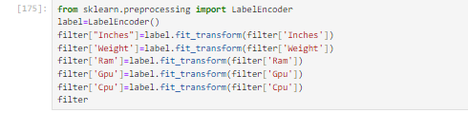
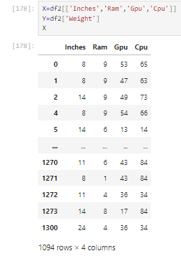
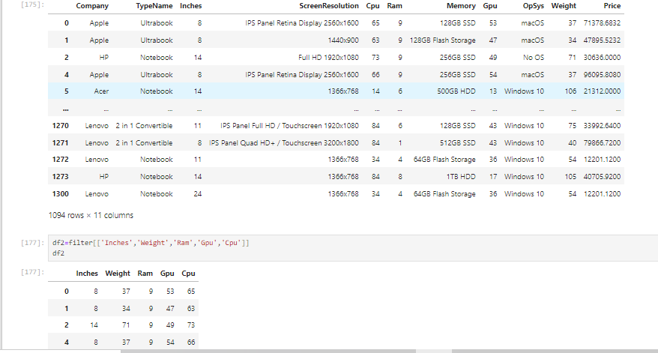

Chisquare Testing

Slide 16
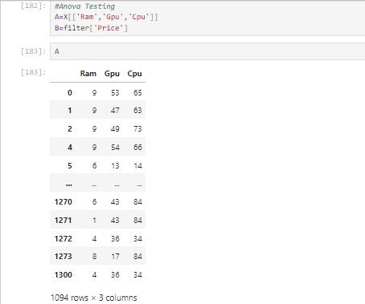
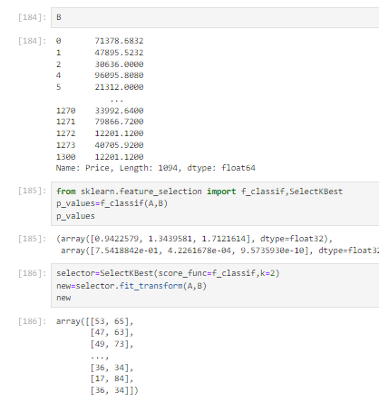
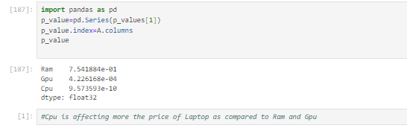
Anova Testing

